Slide 1
InnovationQ Plus Quick Start Guide
IP Authenticated Personal Accounts
Get Started, Search, Modify Search, Corporate Tree, Review Results, Visuals, Analyze, Save Work & Export, Support Resources
Updated August 2017

Slide 2
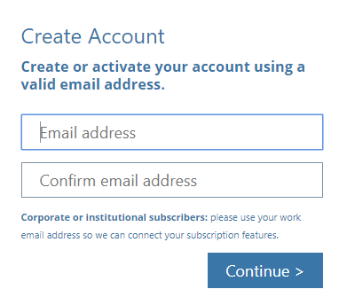
Quick Start Guide: Get Started – Logging In
Set Up Personal Account and Log In
You will be automatically given access to InnovatonQ Plus via IP Authentication within the IP authenticated area. Set up and sign into a personal account to unlock additional features, including saved work, exports and analyze.
Go to www.iq.ip.com
Click one of the links prompting you sign in
Already set up? Enter named seat login credentials: email address and password
First time setting up? Click “Create” under “Need Personal Account” and follow prompts
Note: Named seats are NOT subject to IP Auth “simo” limit (limit to number of simultaneous users at one time)
08/2017

Slide 3
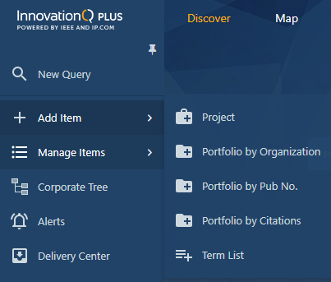
Quick Start Guide: Get Started
B
A
D
B
Log into InnovationQ Plus and begin searching right away, create portfolios, or access saved work to pick up where you left off
Search Bar: Enter your concept search Note: Open the Advanced Query Builder for more options to search
Sidebar menu: Create a new project, open saved work or reports, use a portfolio wizard, or access Corporate Tree
Portfolio Wizards: create a portfolio of patents by publication number, company/organization, or create a portfolio of forward and/or backward citations
Knowledge Base: Visit the Knowledge Base for help and to learn more about InnovationQ Plus
C
08/2017

Slide 4
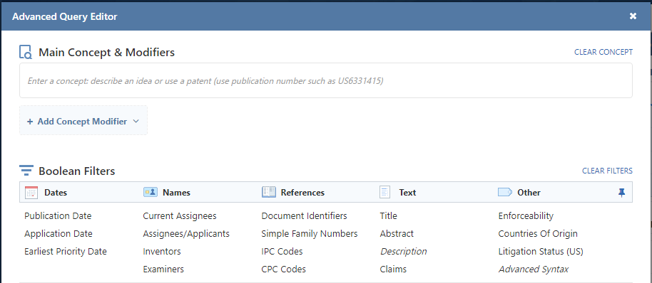
Quick Start Guide: Search
A
Select content to search
Enter a main concept
Add concept modifiers and/or Boolean filters (see pages 4-5)
B
C
SEARCH – Use the query box on the landing page or open the Advanced Query Editor
Type a concept query into the query box, such as:
Natural language description of what you’re looking for
Cut and paste text from a patent, non-patent literature, invention disclosure, email, or any meaningful text
An entire document – type the publication number with the country code, e.g. US7123456
*Please note: For security purposes, queries are deleted within 24 hours if not saved*
08/2017

Slide 5
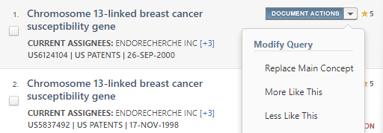
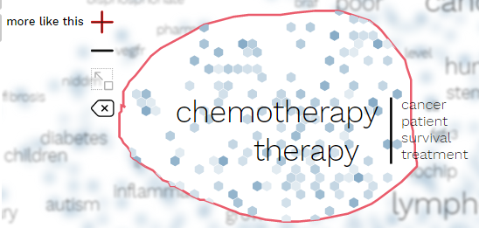
Quick Start Guide: Modify Search - Focus
Concept modifiers are an important and effective way to focus results in a certain area by up- or down-weighting a concept(s) and pushing results to be “more like” or “less like” the modifier(s)
Concept Modifiers can be:
Text Note: Terms the Term Heat Map/Cloud may provide insight into concept modifiers. Your concept modifier may be present in the main concept. The concept modifier helps direct the engine to what is important (or less important) and re-sorts the results to show the most relevant results to the top.
Entire document
Area of the Semantic Map
A
B
C
08/2017

Slide 6
Quick Start Guide: Modify Search - Filters
Boolean Filters
Add Boolean filters to a concept query or create a filter-only query
Select one or more filters and enter filter criteria
Filters are defaulted to “Limit to” and may be changed to “Exclude” Note: Use caution when using “Exclude” filters to avoid eliminating important art
Non-Patent Literature and Patents + NPL have different filters available due to the limited fields available
Easily filter from some visualizations for easy and fast visual searching
08/2017

Slide 7
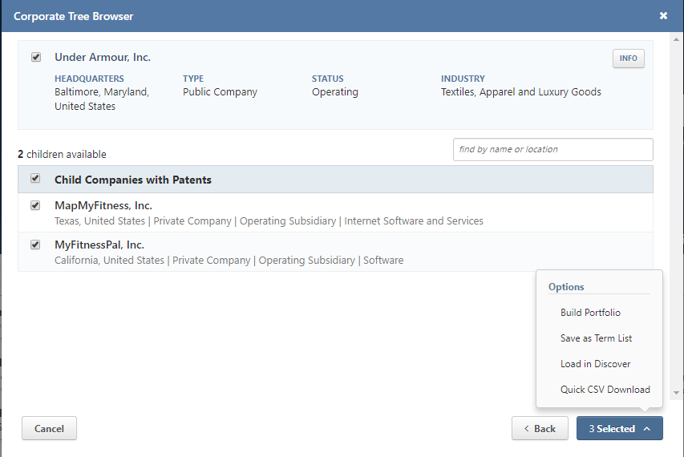
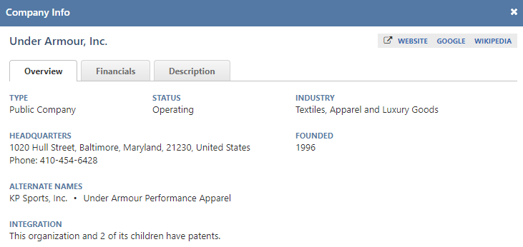
Quick Start Guide: Corporate Tree
Accessing the Corporate Tree
The Corporate Tree helps create accurate and thorough patent portfolios, explore company relations, and view company financial information.
Three places to access the Corporate Tree:
Sidebar Menu (shown)
Portfolio by Organization Wizard
Sidebar Menu > Add Items > Portfolio by Organization
Note: Use Portfolio by Organization Wizard to leverage Corporate Tree and name normalization to create the most complete and accurate portfolios
Current Assignee Filter
Using the Corporate Tree
Enter entity name and search
Click “VIEW” to see ultimate parent and children with patents (searchable)
Click “INFO” to view company information
Select ultimate parent and children and click “Selected” menu to:
Build portfolio of patents assigned to the entity name(s) selected
Save as Term List to be accessed later or used as a filter
Load in Discover to load patents assigned to entity name(s) selected
Quick CSV Download
A
C
B
Search Children
D
C
08/2017

Slide 8
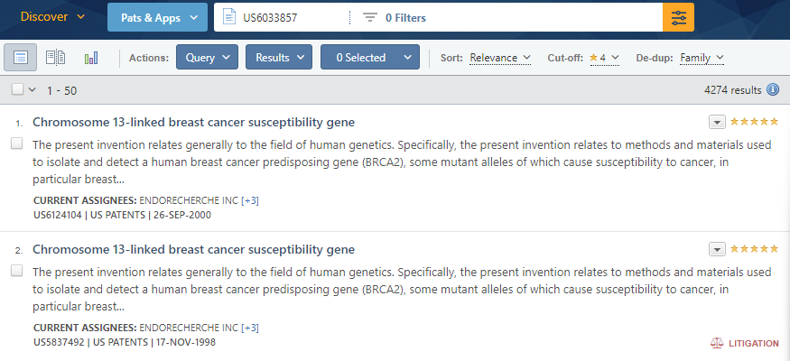
Quick Start Guide: Review Results – Viewing Results
A
C
D
B
Results are shown below the query. Results are default sorted by relevance on a 5-star scale.
Switch your results view to see a split view (list of results next to a document preview) or visualizations
Click on the document title to open document preview for more detail
Sort by date or relevance and select relevance cut-off
De-dup results by Simple Family or Application Number
08/2017

Slide 9
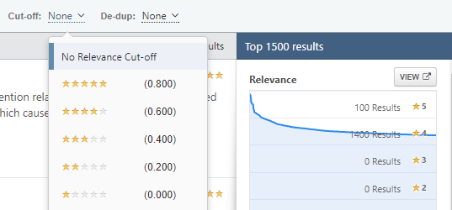
Quick Start Guide: Review Results- Understanding Relevance
Concept search results are given a relevance rating based on relatedness to the query. Set the cut-off depending on the goal.
4 and 5 star results share most or all of the concepts from the query (review for possible knockout art)
3 star results share some concepts or features from the query (review for §103 non-obviousness or tangential technology)
1 and 2 star results are not likely important
08/2017

Slide 10
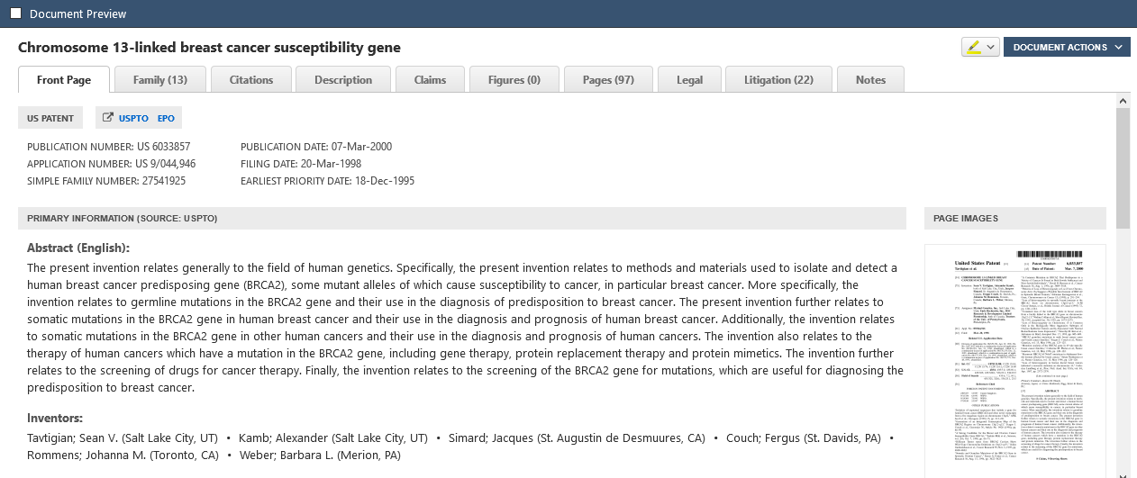
Quick Start Guide: Review Results - Document Preview
Click on the document title to open the document preview
Click through the tabs to view document details
08/2017

Slide 11
Quick Start Guide: Review Results - Highlighting
A
C
C
B
Highlighting:
Turn on highlighting within the document preview
Keyword highlighting widget shows where a term appears in the document
Click “Customize” to view query terms, concept terms and add/remove terms to highlighting
Note: Concept terms provide a glimpse into the semantic engine by showing concepts prevalent in the result set.
08/2017

Slide 12
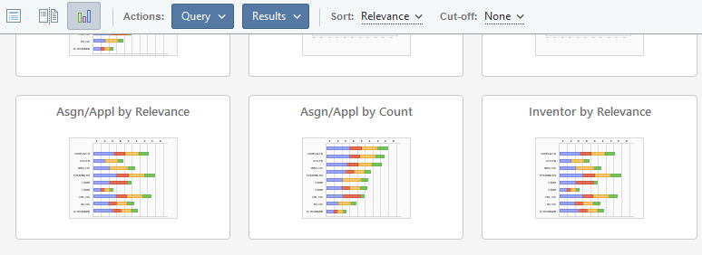
Quick Start Guide: Review Results – Visual Temperature Checks
Visual Temperature Checks:
In addition to the Results Concepts shown in highlighting, visualizations may also provide visual temperature checks to see if you’re on the right track and provide insight into the quality of the results.
Click the visualizations view from the result set, and chart options will appear including “Term Heat Map” and “Term Cloud.” These visuals also provide transparency into the semantic engine, just like within highlighting.
08/2017

Slide 13
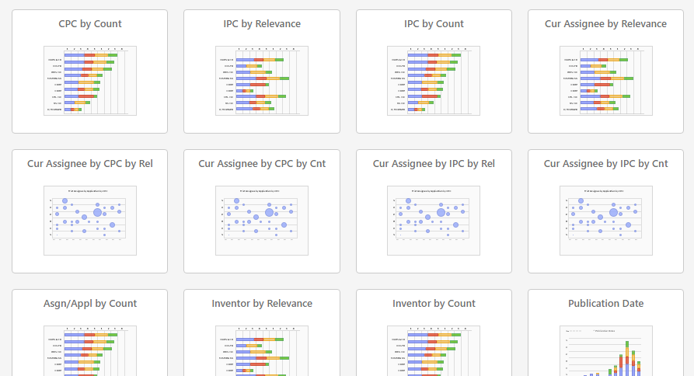
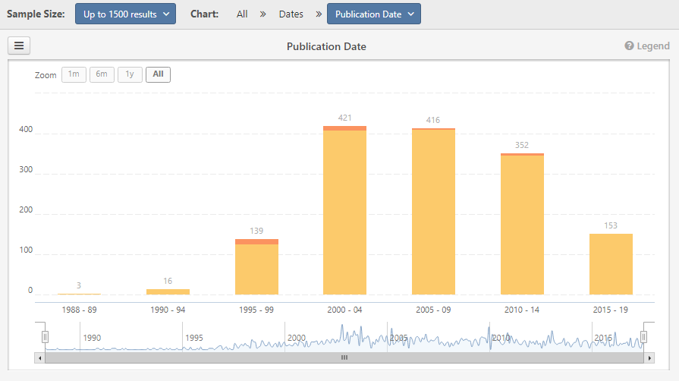
Quick Start Guide: Visuals– Visualization
A
Visualization:
Quickly learn about top results via a variety of charts available in the visualizations view.
Visually search using built in filters
Download images
08/2017

Slide 14
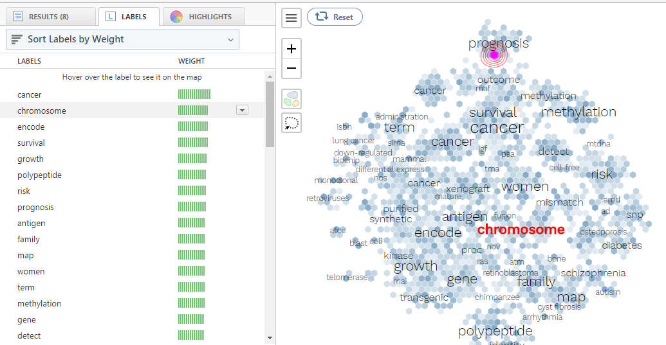
Quick Start Guide: Visuals– Semantic Map
D
B
The darker the shade, the higher the concentration of documents to see trends Note: When you click on a honeycomb, concentric circles appear, also correlating to how many documents are contained within
Use the tool to select an area of the Map. Free lasso or use auto regions to learn more about areas of the Map and zoom to dig in
View results, a list of Map labels showing weight on the Map, or Highlight to color the Map by assignee or S&P ultimate parent
C
Semantic Map:
The Semantic Map is an interactive tool that shows a visual representation of results and provides insight into the relationships between the documents. Labels seek to help understand what is unique about the documents in various regions.
08/2017

Slide 15
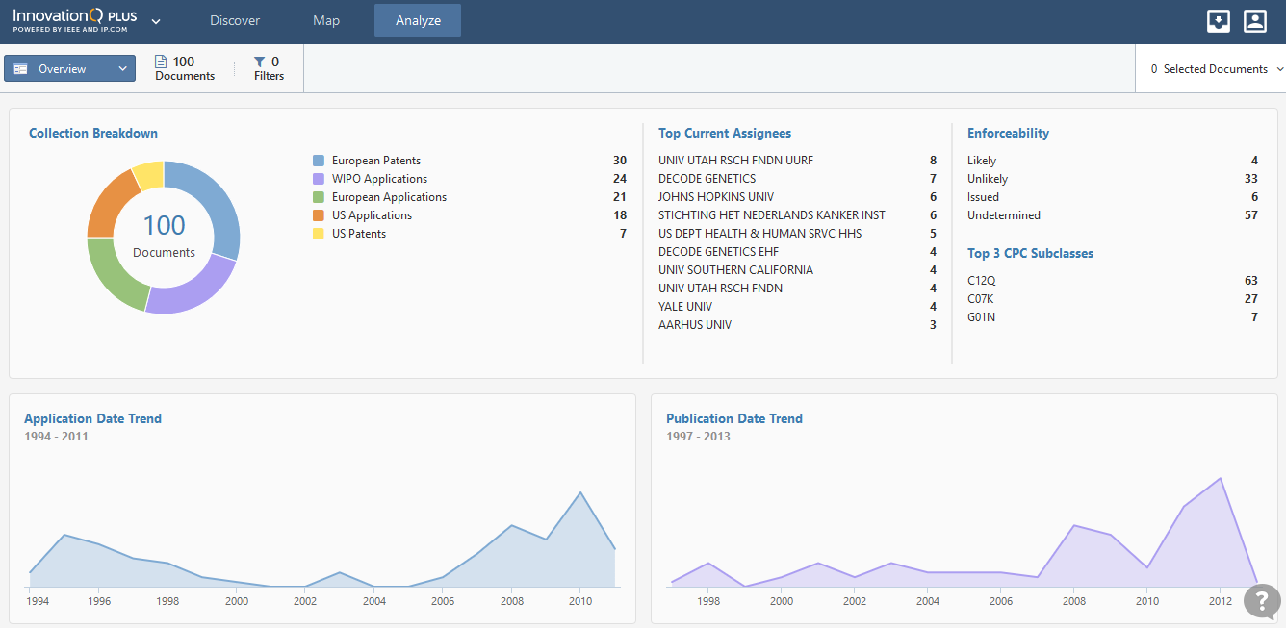
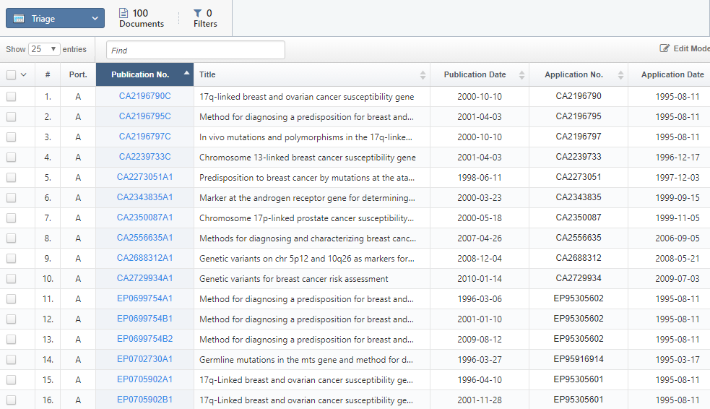
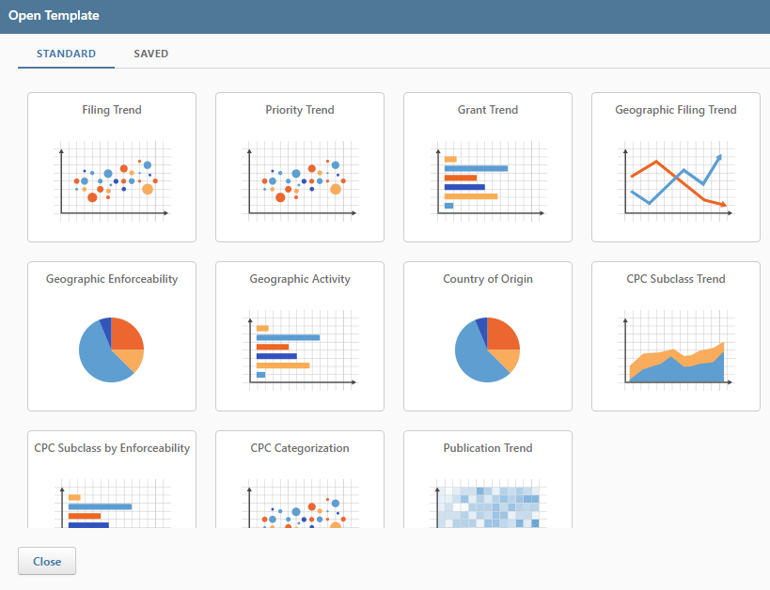
Quick Start Guide: Analyze
Analyze:
Load portfolios into Analyze to understand patent data and extract knowledge and information. Filter, zoom, and edit charts on the fly and create meaningful visuals. Analyze provides 3 views:
Overview – dashboard view of documents
Triage – sort and search in a spreadsheet view
Charts – create highly customizable charts
08/2017

Slide 16
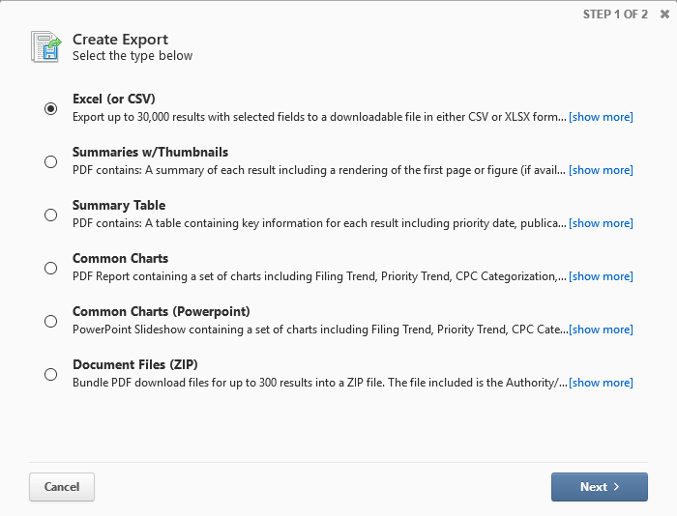
Quick Start Guide: Actions and Exports
Result Actions:
Use Actions Menus:
Query: save queries, create alerts, export query text
Results: save results or export from the results set
Selected: Select documents with check boxed and save and export the selected documents only
Exports:
There are a variety of options for exports. Choose “Create Export” under the Results Actions menu
Export data in CSV, XLSX, PDF, PPT, and ZIP
Exports can be accessed in the Delivery Center found in the sidebar menu or Delivery Center icon in the upper right corner
Note: Exports expire 90 days after creation. Attach exports to a project to save in InnovationQ Plus, email, or save the file
08/2017

Slide 17
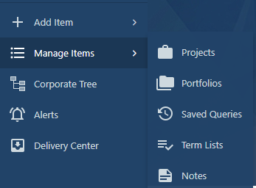
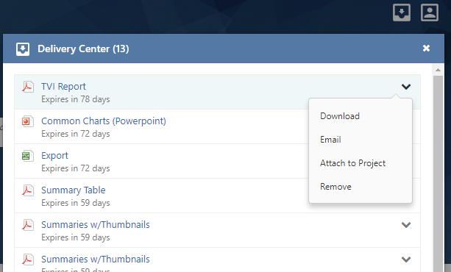
Quick Start Guide: Saved Work
Create a Project:
Create a project to save portfolios, queries and terms list into. Attach exports to projects to save. Share projects with colleagues on the same subscription
Open the sidebar and click Add Item > Project
Saved Work:
Access and manage saved work from the sidebar menu
Open the sidebar and click Manage
Select item type to open
Delivery Center:
Access exports and exports from the Delivery Center in the upper right corner or in the sidebar menu
Items expire in 90 days from the Delivery Center
Download, email, or attach items to a project
08/2017

Slide 18
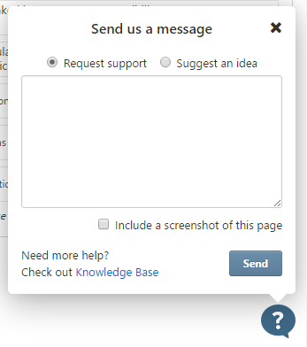
Quick Start Guide: Support Resources
We’re here for you! We’re available to answer questions and provide training to ensure you are getting maximum value from InnovationQ Plus
Contact us from InnovationQ Plus: Click the “?” at the bottom right corner of every screen to ask questions, report difficulties, or provide feedback
Knowledge Base: http://guide.ip.com
Customer and Technical Support
E: iqplus@ieee.org
P: 800 678 4333
Contact your representative at IP.com, your IEEE account manager, or the IEEE Client Services team at training@ieee.org.
08/2017

Slide 19
Visit: www.ieee.org/innovationqplus

